Slide 1
Venture Capital
4/2/2024

Slide 2
Agenda
Oluwafunmilayo Somoye Karan Mudaliar Arya Shukla William James Yunke Nie Hamidreza Komaki Stephen O'Neil
== Break ==
How to talk to VCs
Tufte

Slide 3
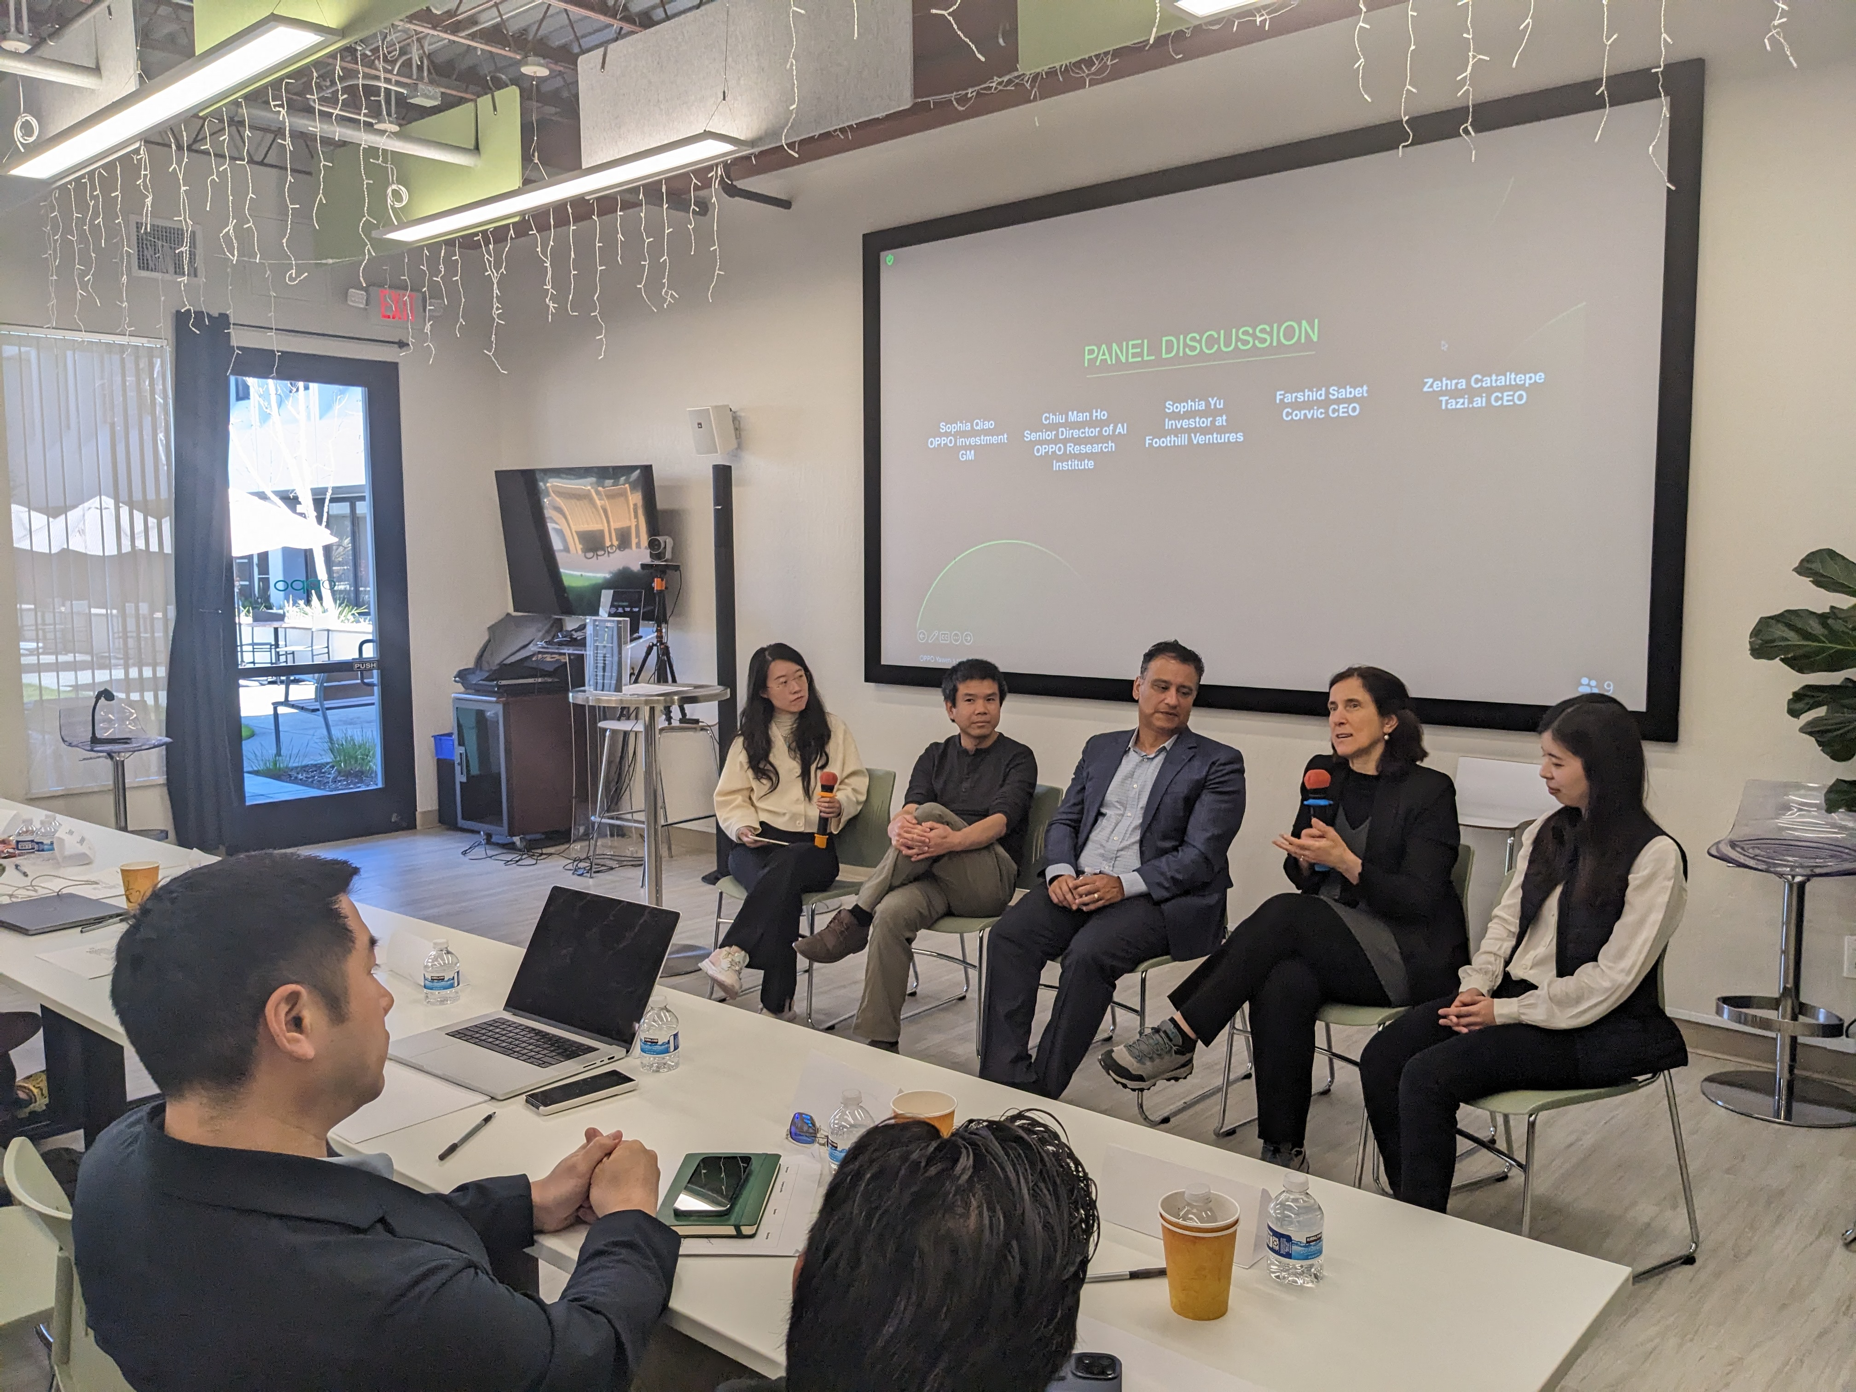

Slide 4
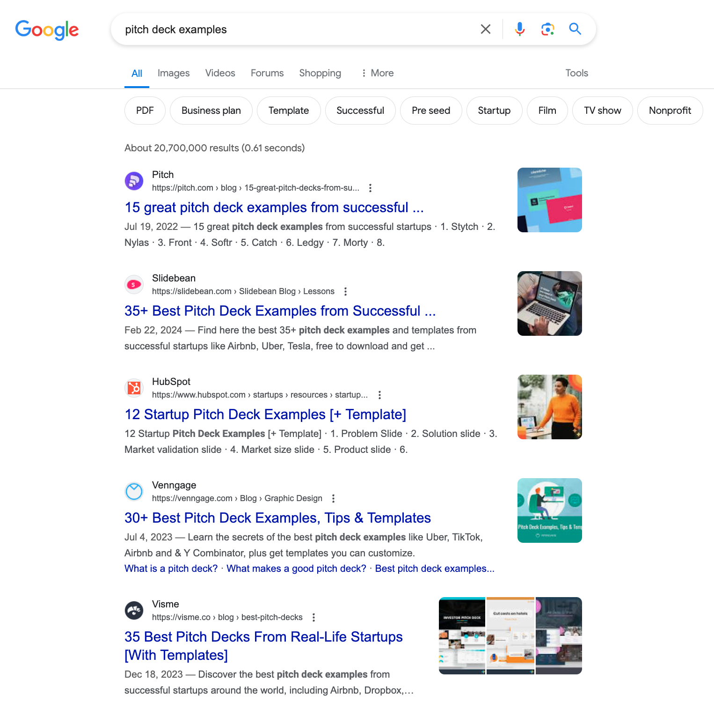
Too much “free” advice

Slide 5




Best Sellers

Slide 6


Slide 7

https://articles.sequoiacap.com/writing-a-business-plan
Company purpose Start here: define your company in a single declarative sentence. This is harder than it looks. It’s easy to get caught up listing features instead of communicating your mission.
Problem Describe the pain of your customer. How is this addressed today and what are the shortcomings to current solutions.
Solution Explain your eureka moment. Why is your value prop unique and compelling? Why will it endure? And where does it go from here?
Why now? The best companies almost always have a clear why now? Nature hates a vacuum—so why hasn’t your solution been built before now?
Market potential Identify your customer and your market. Some of the best companies invent their own markets.
Competition / alternatives Who are your direct and indirect competitors. Show that you have a plan to win.
Business model How do you intend to thrive?
Team Tell the story of your founders and key team members.
Financials If you have any, please include.
Vision If all goes well, what will you have built in five years?

Slide 8
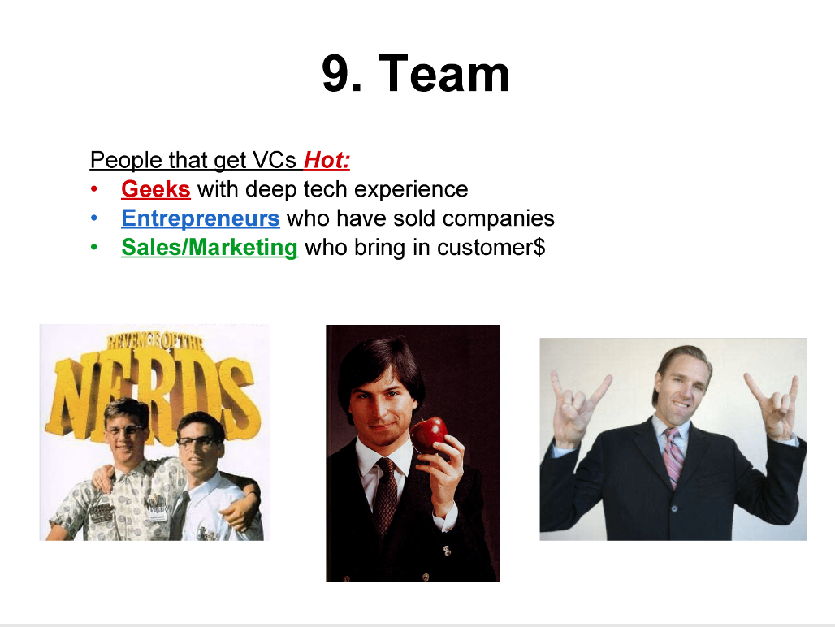

https://www.alexanderjarvis.com/top-vc-shares-guide-to-pitch-deck-outline-for-startups-fundraising/

Slide 9

VecML.com

Slide 10

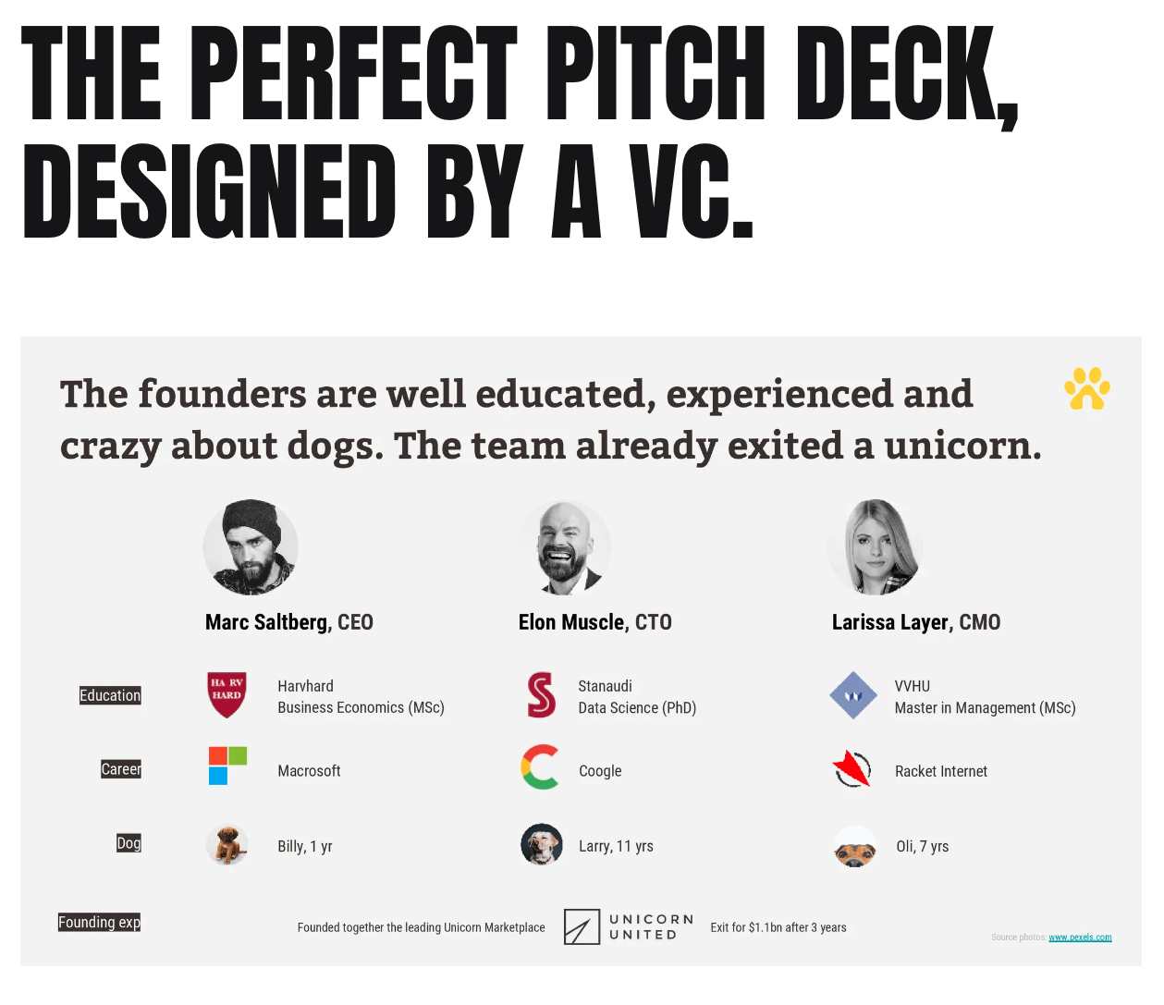
https://www.fundraisingcoup.com/perfectpitchdeck

Slide 11
Introduction to data display and visualization
Omar Alonso
6-April-2023

Slide 12
Agenda
High level introduction
Main concepts
Why this is important
Grad level class at NEU
Many books and online resources

Slide 13




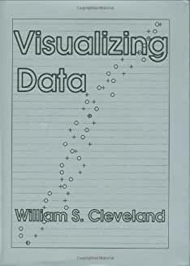
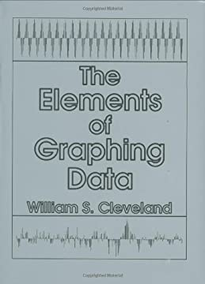


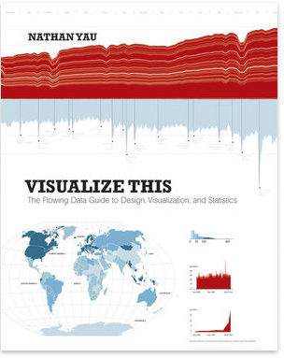
Books

Slide 14
Why data viz is important?
All technical documentation contains
Tables
Figures
Diagrams
You need to communicate main findings and results
Data presentation helps business decision
Avoid visualization overload
Lots of technologies
Design for an audience

Slide 15
Graphical excellence
Well-designed presentation of interesting data: a matter of substance, of statistics, and of design
Complex ideas communicated with clarity, precision, efficiency
Requires telling the truth about the data

Slide 16
Data
Show the data
Help the reader to think instead of methodology, graphic design, viz
Facilitate comparison and to illustrate causality
Serve a purpose
Data collection
Learn all you can about your data before any viz

Slide 17
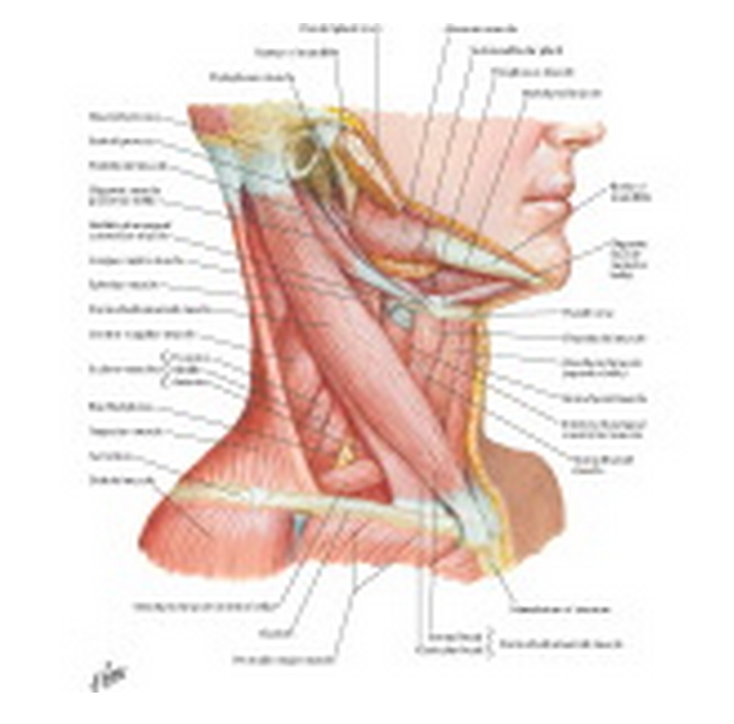
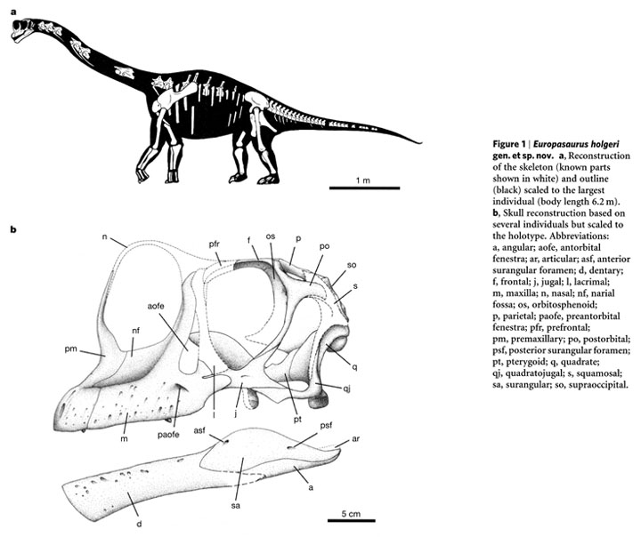
Annotations
Add labeled arrows
Circle anomalies
Explanations near the data

Slide 18
Avoid clutter
Present information without creating confusion
Text needs to be easy to read
ADVANCED TOPICS IN DATA SCIENCE
Advanced Topics in Data Science
Use colors carefully
Don’t obfuscate the data display

Slide 19
Graphical integrity
Author names
Dates
Quote data in full context
Show data variation, not design variation
Data-ink ratio: proportion of a graphic's ink devoted to the non-redundant display of data info
Data-ink / total ink used to print the graphic
Be honest

Slide 20

Minard’s map of Napoleon’s March
Size of the army
Location of 2-D surface by date (latitude & longitude)
Direction of movement
Date
Temperature

Slide 21
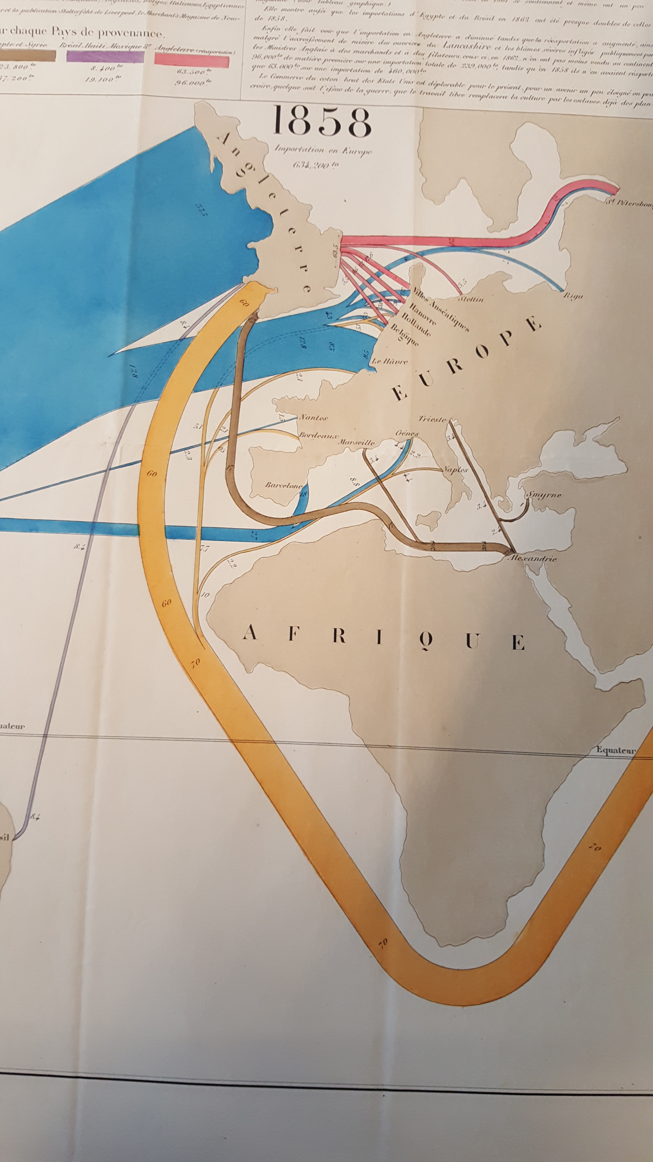
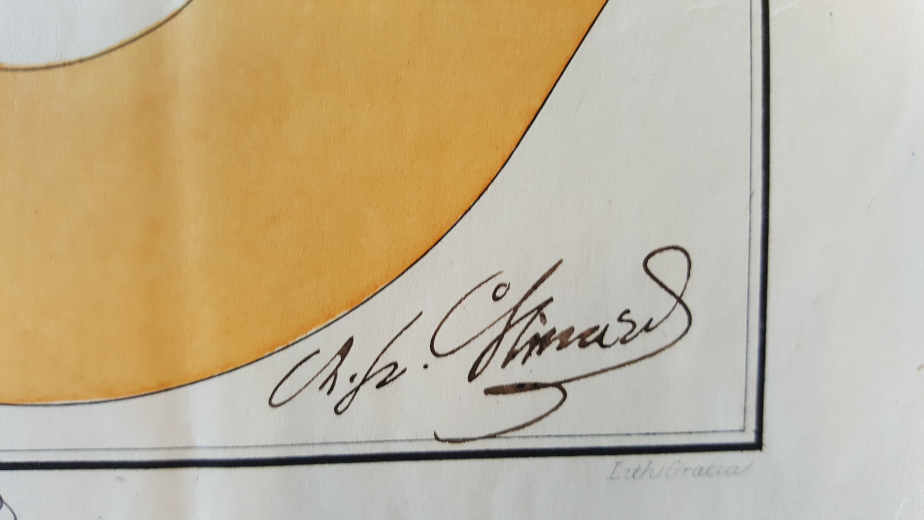
Charles Minard
Many other maps
Carte figurative

Slide 22
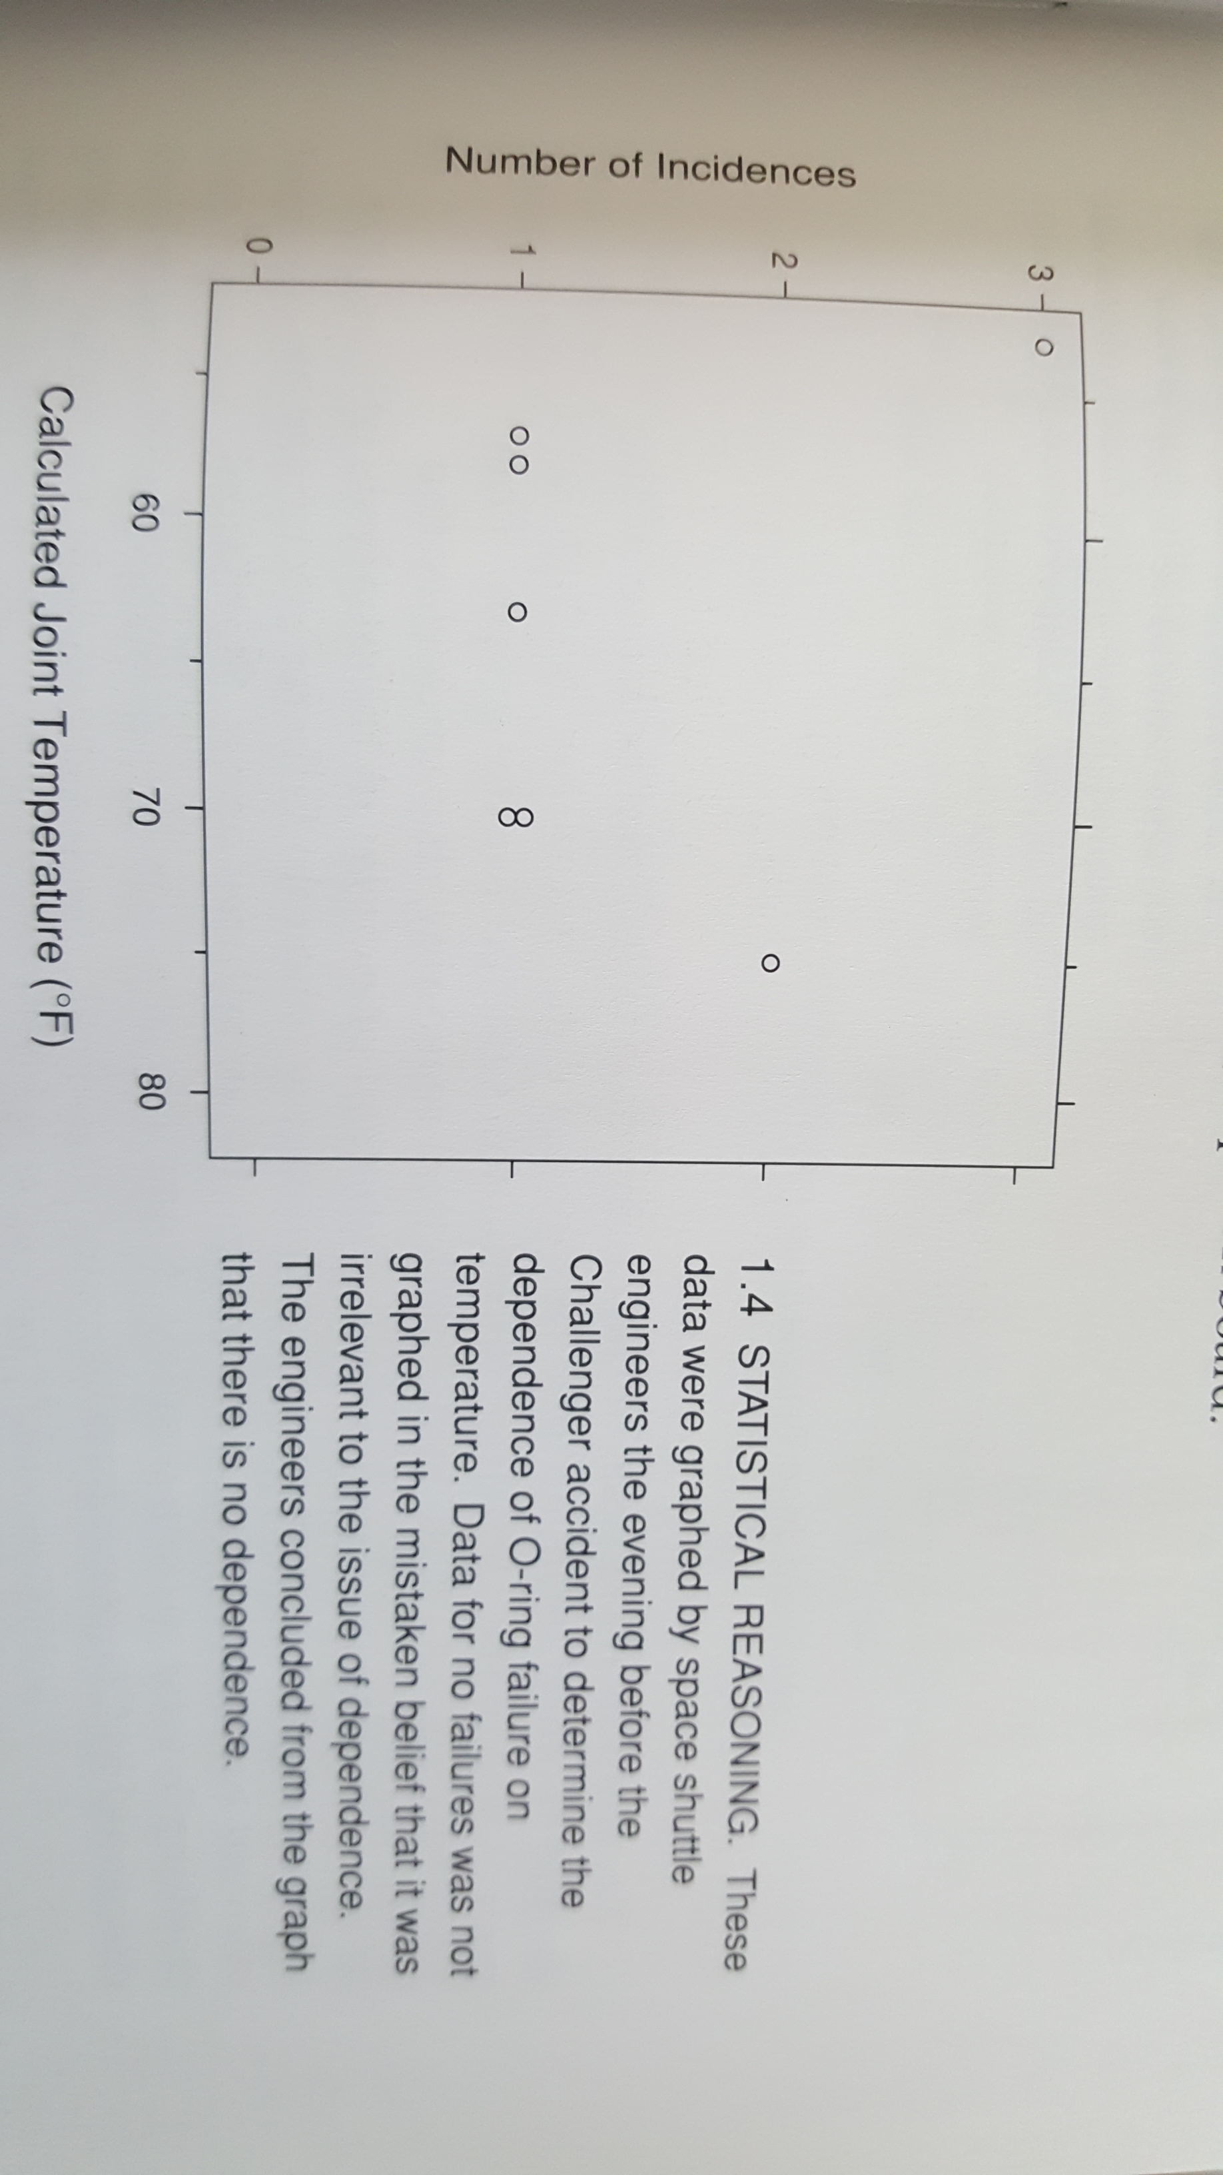
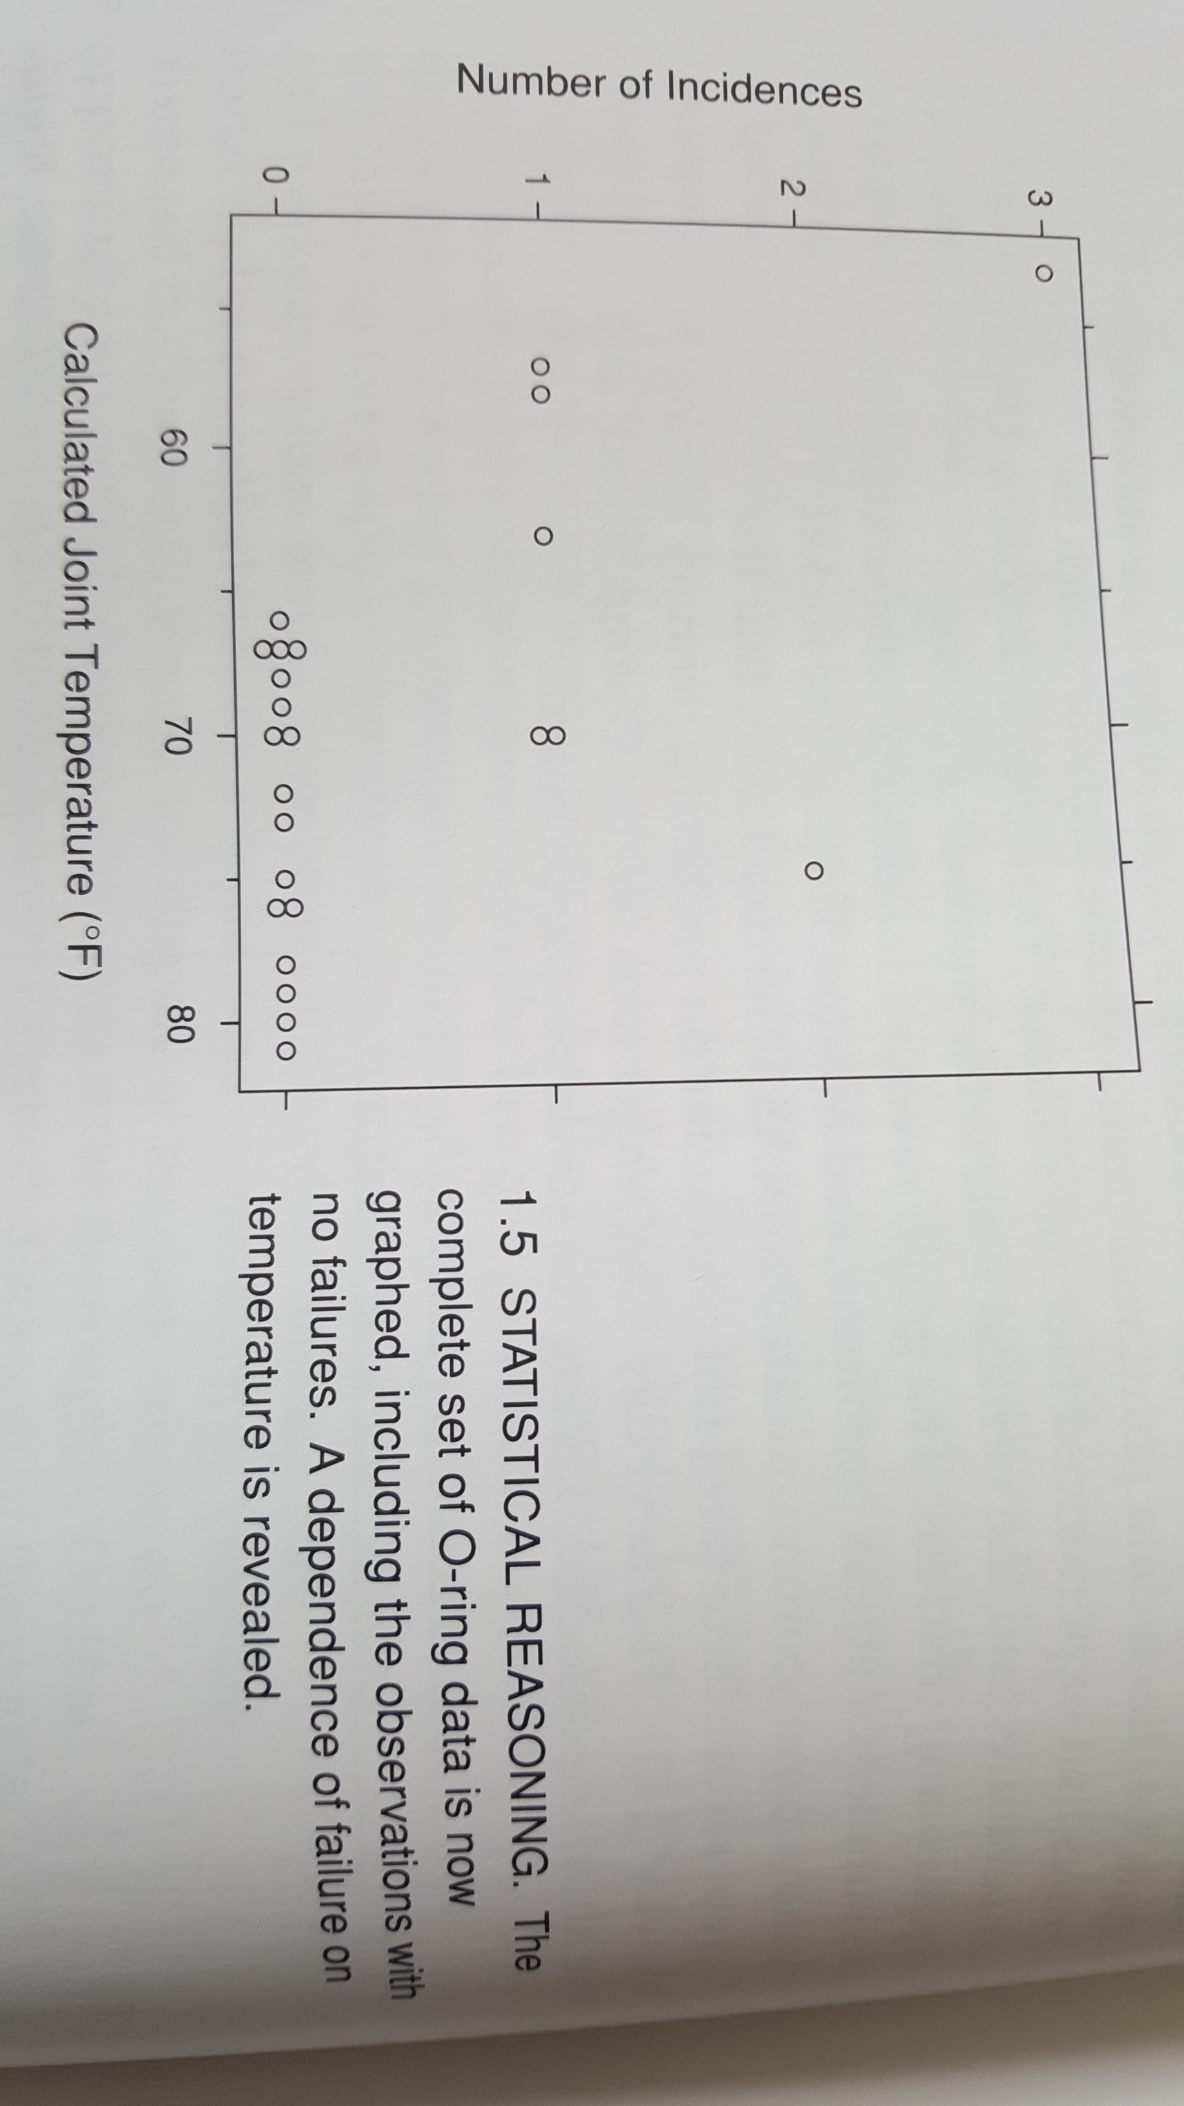
The decision to launch the Shuttle Challenger
In 1986 the shuttle Challenger exploded because two rubber O-rings leaked
The engineers who designed the rocket opposed launching
Evidence presented was inconclusive

Slide 23
Information Visualization
Explore, present, describe meaning
Communicating and clarifying ideas
Components
Visual cues
Coordinate system
Scale
Context

Slide 24
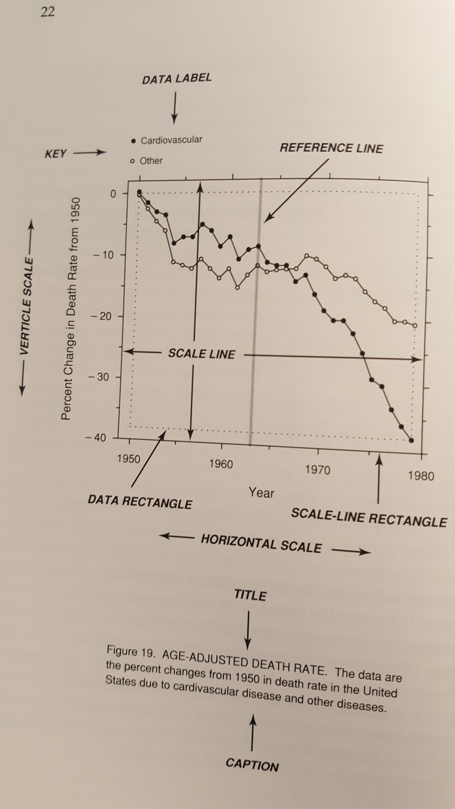
Principles of graph construction
Scale-line
Data rectangle encloses data
Data labels
Make the data stand out
Make captions informative and comprehensive
Describe everything that is graphed
Draw attention to the important features of the data
Describe the conclusions that are drawn from the data on the graph

Slide 25

PowerPoint and presentations
Tufte’s critique
PPT is presenter-oriented, not content-oriented, not audience oriented
Replace PPT with word-processing software

Slide 26
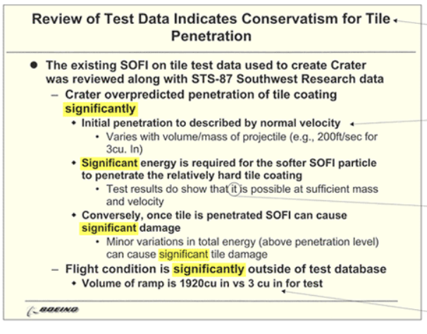
Assessing the quality & credibility of tech reports
Does PPT cognitive style affect the quality of engineering analysis?
Columbia shuttle
82 seconds after liftoff, a 1.67 pound piece of foam broke and damaged the wing’s thermal protection
Burned up during re-entry
Some tools are better than others for engineering
Tech reports > PPT
None of the 5 “significants” refer to statistical significance
Vague reference to “it” -> damage to the left wing
Unit of measurement is shown in different ways
https://www.edwardtufte.com/bboard/q-and-a-fetch-msg?msg_id=0001yB

Slide 27
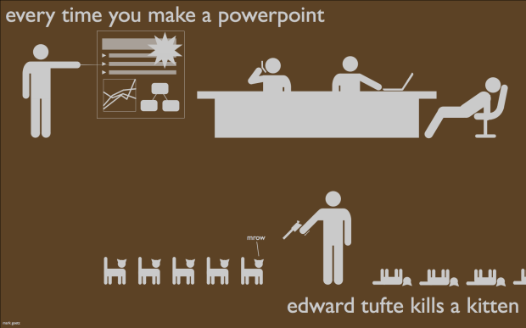
We’re all guilty
https://flowingdata.com/2010/03/20/powerpoint-and-dying-kittens/
https://markandrewgoetz.com/

Slide 28


Narratives
The first 20min of many meetings
Six-pager (~ 3min per page)
Narratives produce clear thinking
Stimulate discussion
Ideas matter most
A document is portable and easy to circulate
https://conorneill.com/2012/11/30/amazon-staff-meetings-no-powerpoint/

Slide 29
Links
Edward Tufte (https://www.edwardtufte.com/tufte/)
Marti Hearst “Search User Interfaces” (https://searchuserinterfaces.com/)
J. Heer et al. “A Tour through the Visualization Zoo” (https://dl.acm.org/doi/10.1145/1794514.1805128)
Processing (https://processing.org/)
D3 (https://d3js.org/)
The Gettysburg PPT Presentation (https://norvig.com/Gettysburg/)

